Slide 1
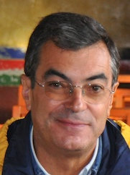
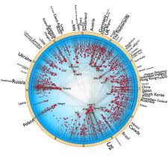
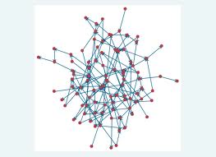
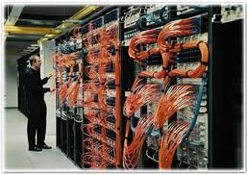
DEPARTAMENTO DE INFORMÁTICA
Edge Controlled Networking
José Legatheaux
Photo
(Professor)
SOFTWARE SYSTEMS / Computing Systems
José Legatheaux Martins is a professor of distributed computer systems and computer networks at the Department of Informatics of DI-FCT/UNL.
José graduated from FCT/UNL in Engenharia Informática in 1979. From 1983 to 1987 he was a researcher at INRIA. From 1988 to 1992 he was with Faculdade de Ciências de Lisboa. Since 1993 he is with FCT/UNL. He had a pivotal role in the early development of the Internet in Portugal and is a founding member of CITI.
His former research interests were related with cooperation, coordination and data management for distributed collaborative and mobile systems.
Recently he focused on algorithms and protocols for adaptive and efficient routing in large scale networking systems.
The main intermediate tasks of this research are:
To devise algorithms using diversity and fault-tolerance criteria to select multiple paths for routing in large and complex networks.
To devise aggregation methods to optimise the way these paths are known to the network nodes and edge devices.
To devise routing methods and control systems allowing the exploitation of that path diversity by the edge of the network in a scalable way.
To relieve network gear from the burden of timely adapting to faults and load variations what will permit unforeseen scalability growth in size and capacity.
Algorithms able to compute paths and and tree-shaped sub-graphs to support multi-path routing. These results can be used for MPLS or VLAN based multi-path routing as well as to support new routing protocols.
A comparative study of new and old multi-path routing techniques and load distribution techniques.
An new architecture for network control and its evaluation in several scenarios. That architecture will support a more flexible division of the control responsibilities between the core and the edge.

