Slide 1
Mapping Security Standards Adoption in the Internet or The Long and Painful Path to Security
José Legatheaux Martins
Departamento de Informática da FCT/UNL

Slide 2
Trust and Security on the Internet
The principles of the basic architecture of the Internet have always favoured simplicity and scalability over security
This was a clever decision since, at that time, it prevented the adoption of wrong solutions to then poorly understood problems and technologies, which would have make the Internet architecture centralized, fragile and unable to scale and evolve.

Slide 3
Could it have been different?
Public-Key Cryptosystems, the foundation of scalable decentralized security, were invented after TCP/IP was being “standardized” (late 70’s - early 80´s)
During the 90’s the use of strong Symmetric Cryptosystems in the Internet was forbidden
Cerf, V.; Kahn, R. (1974). "A Protocol for Packet Network Intercommunication". IEEE Transactions on Communications, 2 (5): 637–648.
Vinton Cerf, Yogen Dalal, Carl Sunshine (December 1974), RFC 675, Specification of Internet Transmission Control Protocol
Diffie, Whitfield; Hellman, Martin E. (November 1976). "New Directions in Cryptography". IEEE Transactions on Information Theory. 22 (6): 644–654
Rivest, R.; Shamir, A.; Adleman, L. (February 1978). "A Method for Obtaining Digital Signatures and Public-Key Cryptosystems". Communications of the ACM. 21 (2): 120–126.

Slide 4
Encryption of Content
If used end-to-end: only the audience that knows the cryptographic keys can read the content
If only used in parts of the transmission path: listening of the public parts of the path is made impossible

Slide 5
Cryptographic Signature
Proofs the identity of the sender (proof of authenticity)
Shows any tampering with the content
Used with timestamp to avoid non-repudiation

Slide 6
Cryptosystems are at the Heart of
Authentication of servers / entities / persons — based on public/private key pairs
Key and other information certificates build with digital signatures - again based on public/private keys pairs
Integrity and confidentiality of messages exchanges

Slide 7
Trust and Security Today
Security mechanisms were added as needed in a continuous trial and error process
Standardized year after year by the IETF
Some of these standards bring new operational costs that sometimes do not immediately produce the intended results
Thus, sometimes, progress in their deployment is disappointingly slow.

Slide 8
When Accessing an URL, We Must Trust
That the DNS mapping to an IP address is genuine
That the routing system is passing packets to the correct endpoint / interface
That the SSL/TLS connection and the site certificate are genuine
That the Web Public Key Infrastructure is not corrupted
That others cannot sniff which site I am trying to access

Slide 9
Most Internet Actors do Not Implement all Possible Security Standards
Does some DNS domain is secured with DNSSEC?
Does my DNS resolution provider (resolver) implements DNSSEC?
Does my ISP implements routing security measures?
Do the sites I visit implement HTTPS with all up to date options and really genuine certificates?
I am using a mail system preventing identity spoofing?

Slide 10
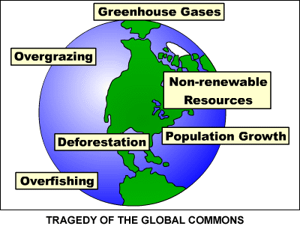
Tragedy of Commons (Garret Harding - 1968)
Security mechanisms add burden, increase operational costs and do not immediately improve providers revenues
They are mostly a common good, and not a direct good of a specific service provider
Unless it looses customers for not implementing them

Slide 11
Agenda
Mapping Routing Security adoption progress
Mapping DNSSEC validation progress
Mapping HTTPS adoption progress

Slide 12
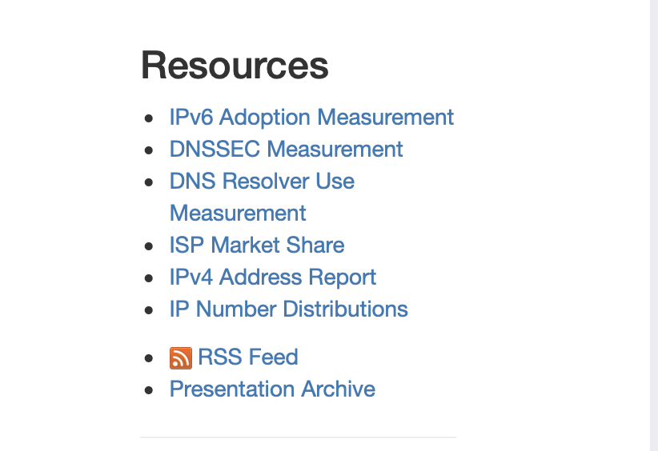
APNIC Observatories
APNIC Laboratories, lead by Geof Houston, setup an extensive Internet Monitoring Infrastructure
https://labs.apnic.net

Slide 13
Securing Routing
BGP – Border Gateway Protocol – The protocol that supports routing packets in the core of the Internet. It has no security measures built in. Mostly defined in the 90’s, got updates in 2006
ROV – Route Origin Validation – It is a certificate allowing network operators to check whether an AS is allowed to originate a given route, signed by the Regional Internet Registry
RPKI – Resource Public Key Infrastructure – the set of mechanisms used to issue and validate ROVs

Slide 14
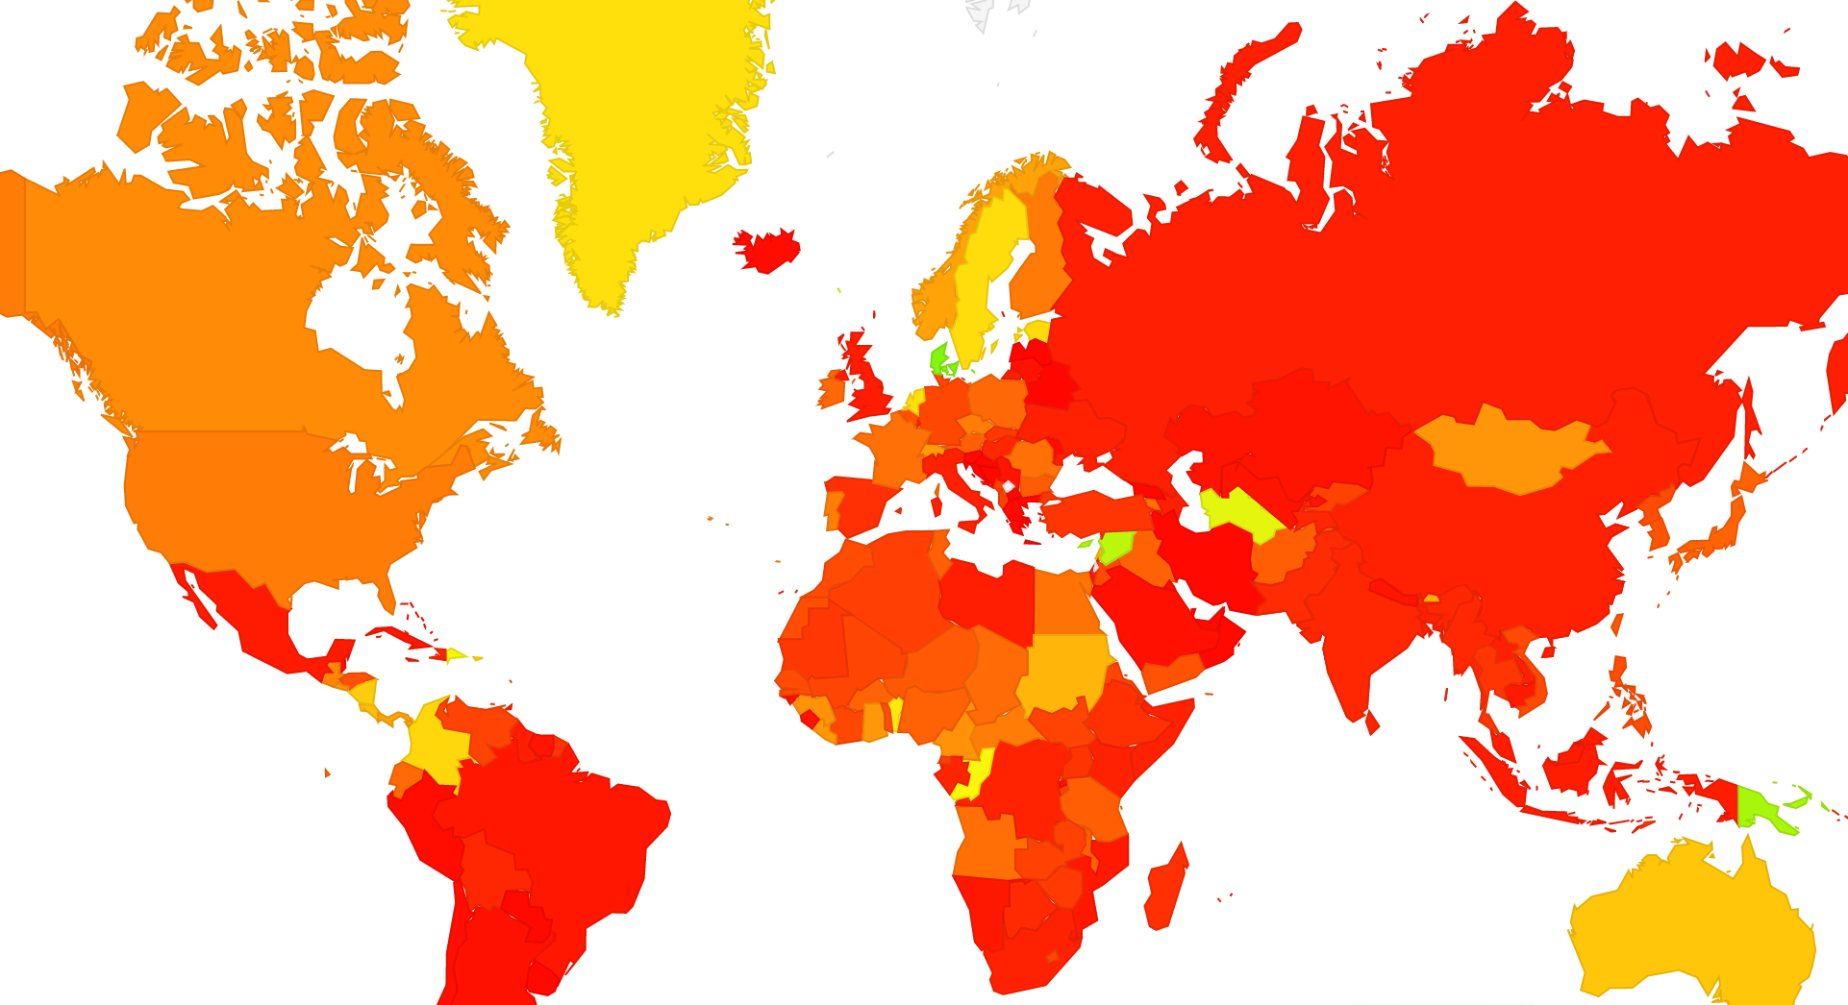
Route Origin Validation Worldwide
Regional NICs assign ranges of IP addresses to Networks
Owners of IP address ranges can publish certificates of the valid routes they can originate
Thus, core routers of the Internet can check if the routes they receive were originated by the owners of the announced IP addresses
This is a step in a good direction since BGPSEC, which fully authenticate routes, is not yet a realistic alternative

Slide 15
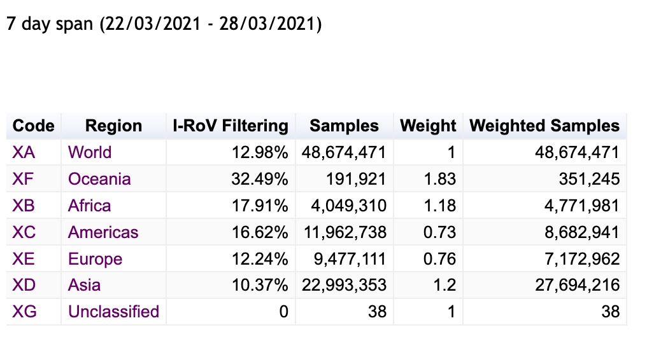
Route Origin Validation (ROV) Worldwide
BGP Prefix Origin Validation – RFC 6811 was published in 2013

Slide 16
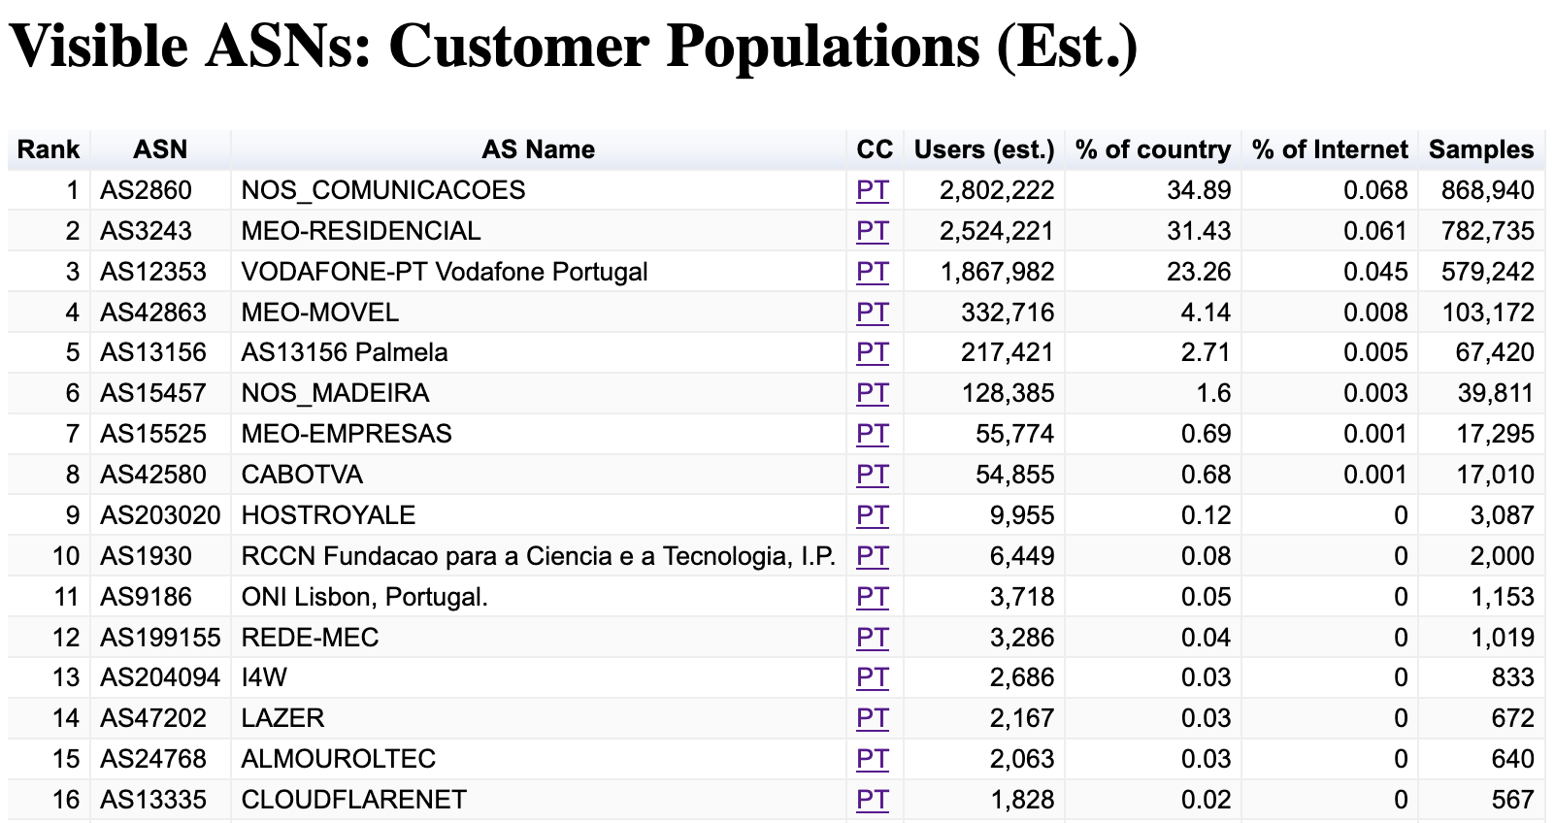
Dimension of Autonomous Systems in PT
4 ASs concentrate more than 90% users

Slide 17
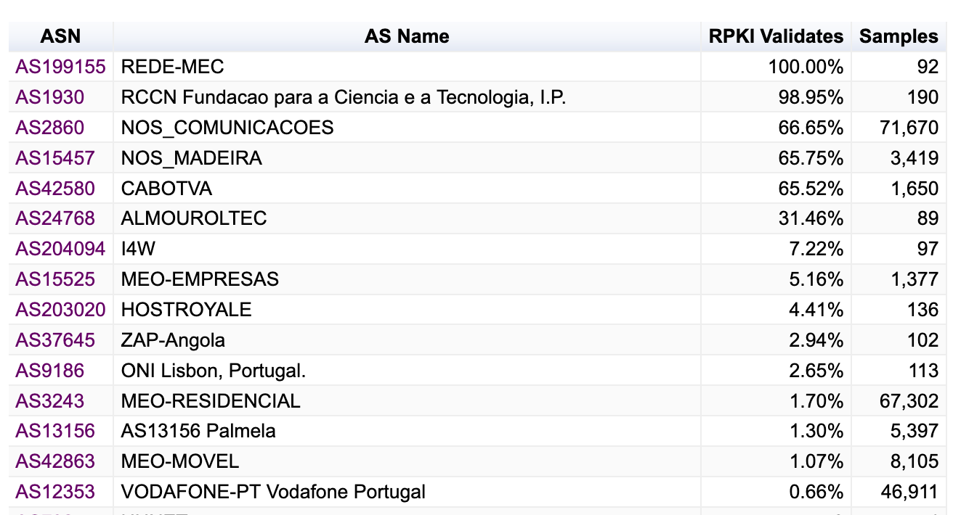
Route Origin Validation in Portugal

Slide 18
DNSSEC Deployment Worldwide
It is easy to test if the domain name of a site is DNSSEC certified. However, one cannot easily find figures on the percentage of domain zones implementing DNSSEC
Of the domains ending in .PT, only around 2.75% of the (active) domains support DNSSEC
Anyway, for those that implement it, do end users receive the benefits of its adoption?
In general, end-system outsource to the so-called resolvers the hard work of navigating the DNS
Do these resolvers perform DNSSEC validation when DNSSEC information is available?

Slide 19
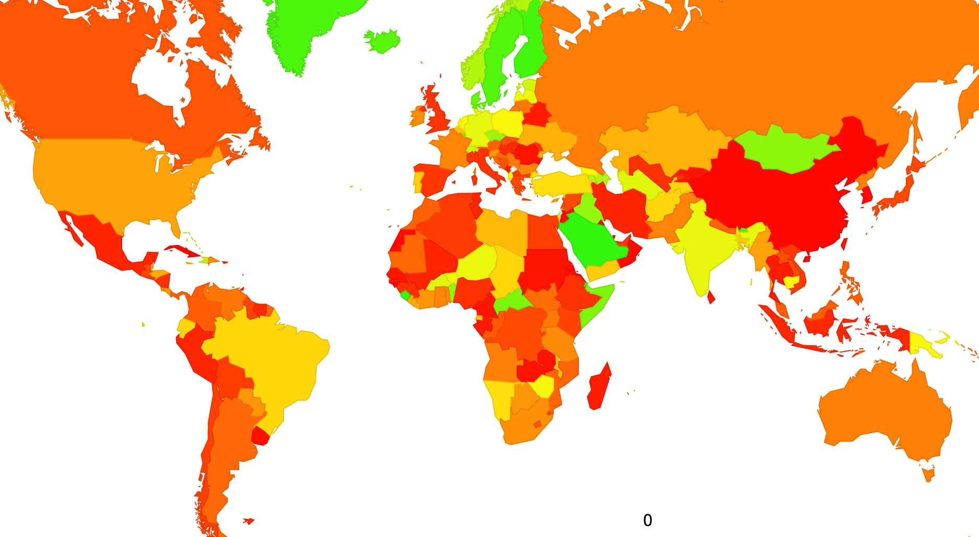
DNSSEC Validation Availability Worldwide
Verifying all DNSSEC signatures by the end systems is not realistic. Thus, users are dependent of their resolvers providers doing it
In this map, green countries are those where most users receive DNSSEC verified information when it is available

Slide 20
DNSSEC Validation Ratio Worldwide

Slide 21
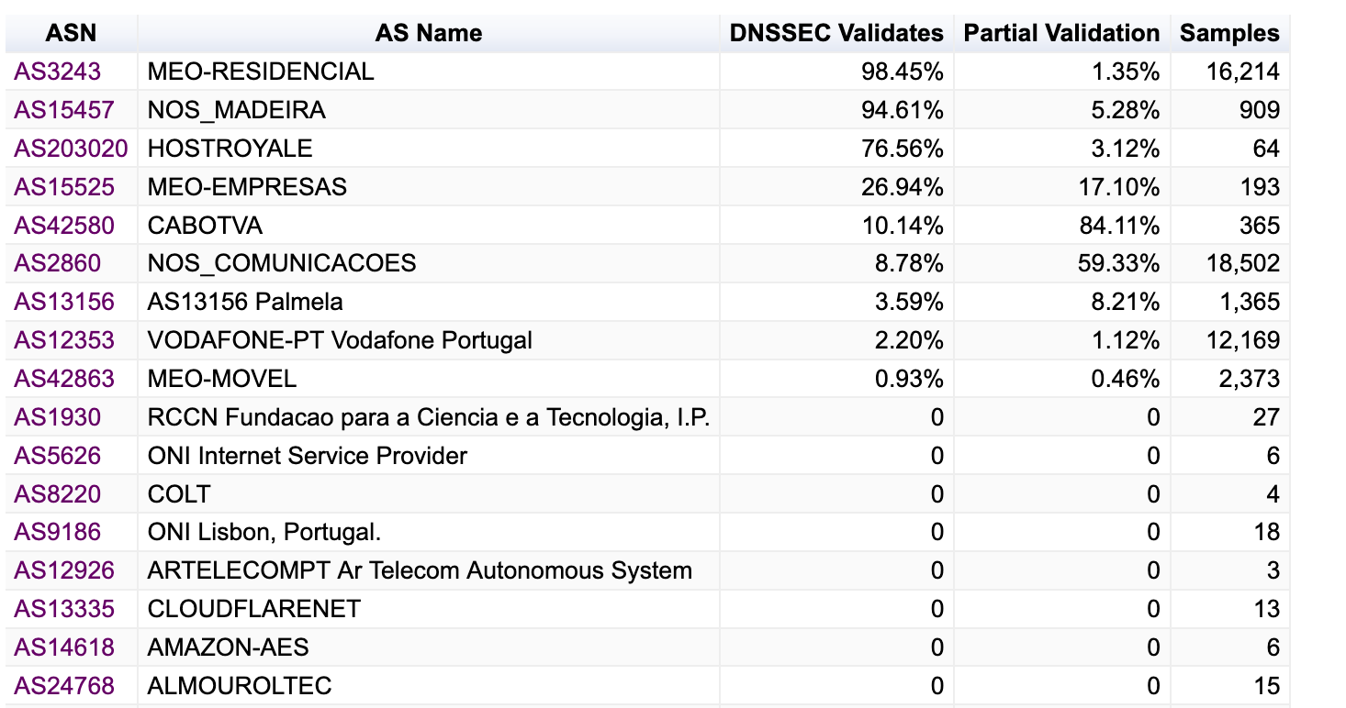
DNSSEC Validation Ratio in Portugal

Slide 22
Transport Layer Security Adoption HTTPS / TLS / Deployment for the WEB and Email Servers

Slide 23
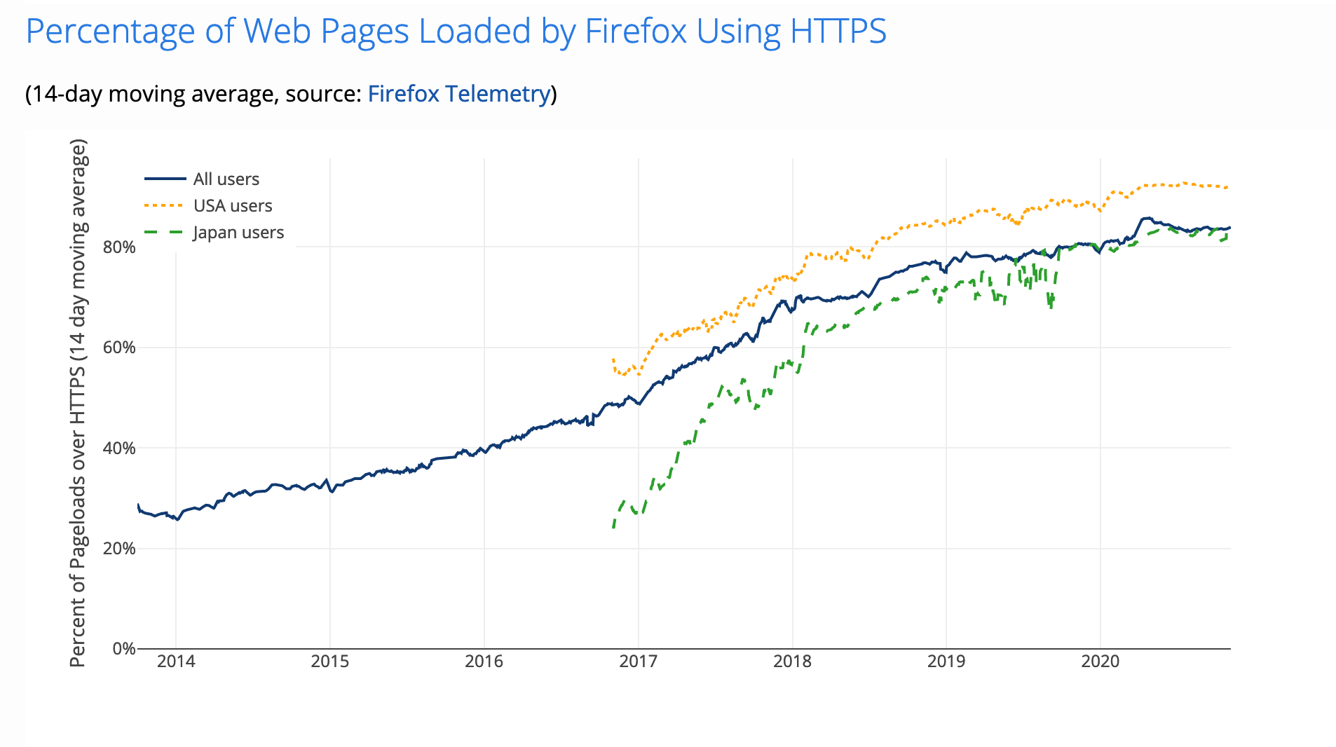
Percentage of Pages Loaded Using HTTPS
Source: https://letsencrypt.org/stats/

Slide 24
Devil is in the Details (of HTTPS)
Does the site redirects HTTP requests to HTTPS?
Does the site has a HSTS (always forcing HTTPS) Policy?
Does the site only uses TLS safe versions?
Do the recommended security HTTP headers are present?
Is the site public key (certificate) and the chain of certificates valid?
As well as:
Does the site supports DANE (DNS Based Authentication of Named Entities – Requires DNSSEC)?
Does the server supports OCSP stapling (presenting short term certification of his certificate validity state)?

Slide 25
Devil is in the Details (of SMTP)
Does the email domain has SPF (Sender Policy Framework) support DKIM (Domain Keys Identified Email) and DMARK (Domain-based Message Authentication, Reporting and Conformance)?
Does the email server only uses safe TLS (or SSL) safe versions?
Is the site public key (certificate) and the chain of certificates valid?
As well as:
Does the server supports DANE (DNS Based Authentication of Named Entities – Requires DNSSEC)?
SPF, DKIM and DMARK information are published on the DNS and are only full proof if the domain supports DNSSEC
Notes:
SPF - This allows receivers to test if the email was sent from an authorized host IP address.
DKIM - It allows the verification of the signature of emails by the email server for the domain.

Slide 26
WEB and Email Security Observatories
Examples of observatories and tools that perform extensive site tests
Mozilla Observatory https://observatory.mozilla.org/analyze
Censys https://censys.io
https://internet.nl
Webcheck https://webcheck.pt
And several others

Slide 27
Analysis of Portuguese Web Providers
Most small and medium users contract their web presence with a hosting provider that provides the management of their DNS, Web server and email service
The way services are implemented by these providers has an huge impact on the security adoption rate by companies
This study encompasses 6 of the todays Top 10 registrars of the .PT domain
By 2019, 4 of these providers managed at least 50000 domains

Slide 28
Web Hosting Highest Security Level Provided
Fornecedor de serviços | IPv6 | DNSSEC | HTTPS available | TLS characteristics | Internet.nl evaluation
PTISP | X | X | Yes | Partial | 34%
AMEN | X | X | Yes | Partial | 32%
DOMINIOS | X | Yes | Yes | Yes | 76%
OVH | Yes | Yes | Yes | Partial | 94%
SAMPLING | X | Yes | Yes | Partial | 66%
WEBSP | X | X | Yes | Partial | 32%

Slide 29
A More detailed View
Fornecedor de serviços | HTTPS redirect | HSTS | HTTPS characteristics | HTTP security headers | DANE | Validity of the certificate | OCSP stapling
PTISP | X | X | Partial | X | X | Yes | Partial
AMEN | Yes | X | Partial | X | X | Yes | Partial
DOMINIOS | Yes | X | Yes | X | X | Yes | Yes
OVH | Yes | X | Partial | X | X | Yes | Partial
SAMPLING | Yes | X | Partial | X | X | Yes | Yes
WEBSP | Yes | X | Partial | X | X | Yes | Yes

Slide 30
Mail Service Highest Security Level Provided
Fornecedor de serviços | IPv6 | DNSSEC | SPF, DKIM, DMARC | TLS support | DANE | Internet.nl evaluation
PTISP | Yes | X | Partial | Partial | X | 44%
AMEN | X | X | X | Partial | X | 35%
DOMINIOS | X | Yes | X | Partial | X | 65%
OVH | X | X | X | Partial | X | 47%
SAMPLING | X | Yes | Partial | Partial | X | 64%
WEBSP | X | X | Partial | Partial | X | 42%

Slide 31
High Level Official Sites Security Level Assessment
Site | IPv6 | DNSSEC | HTTPS available | TLS characteristics | Internet.nl evaluation
OVH | Yes | Yes | Yes | Partial | 94%
presidencia.pt | X | Yes | X | X | 37%
ministeriopublico.pt | X | X | Yes | Partial | 27%
portugal.gov.pt | X | Yes | Yes | Partial | 76%
sg.mai.gov.pt | X | X | Yes | Partial | 37%
seg-social.pt | X | X | Yes | Partial | 32%
parlamento.pt | X | Yes | Yes | Partial | 58%

Slide 32
High Level Official Sites Security Level Assessment
Site | IPv6 | DNSSEC | HTTPS available | TLS characteristics | Internet.nl evaluation
OVH | Yes | Yes | Yes | Partial | 94%
www.tribunalconstitucional.pt | X | X | Yes | Partial | 27%
cne.pt | X | X | X | X | 6%
inem.pt | X | Yes | Yes | Partial | 68%
covid19.min-saude.pt | X | X | Yes | Partial | 39%
sns.gov.pt | X | X | Yes | Partial | 32%
www.min-edu.pt | X | X | X | X | 21%

Slide 33
Some Commercial Sites Security Assessment
Site | IPv6 | DNSSEC | HTTPS available | TLS characteristics | Internet.nl evaluation
OVH | Yes | Yes | Yes | Partial | 94%
olx.pt | X | X | Yes | Partial | 49%
kuantokusta.pt | X | X | Yes | Partial | 47%
wook.pt | X | X | Yes | Partial | 34%
custojusto.pt | Yes | X | Yes | Partial | 66%
proteste.pt | X | X | Yes | Partial | 47%
continente.pt | X | X | Yes | Partial | 49%
leroymerlin.pt | X | X | Yes | Partial | 52%
elcorteingles.pt | X | X | Yes | Partial | 34%
decathlon.pt | X | X | Yes | Partial | 49%

Slide 34
Some Commercial Mail Security Assessment
Site | IPv6 | DNSSEC | SPF, DKIM, DMARC | TLS support | DANE | Internet.nl evaluation
SAMPLING | X | Yes | Partial | Partial | X | 64%
olx.pt | Yes | X | Yes | Partial | X | 75%
proteste.pt | X | X | Partial | Partial | X | 55%
continente.pt | X | X | Partial | Partial | X | 56%
decathlon.pt | Yes | X | Partial | Partial | X | 60%
continente.pt | X | X | Partial | Partial | X | 56%

Slide 35
Conclusions
Security and trust imply the generalized adoption of security open standards
Fully deploying these standards add burden, increase operational costs and do not immediately improve revenues (or impact in the public perception of a brand)
This may explain their slowly adoption rate
Public ignorance of the real adoption status may also help to increase the rate of adoption
Allowing users to have a more informed picture of the situation may improve the rate of adoption

Slide 37
Some University Sites
Site | Score | IPv6 | DNS-SEC | HTTPS redirect | HSTS | HTTPS characteris-tics | HTTP security headers | DANE | Validity of the certificate | OCSP stapling
UMINHO.PT | 71% | X | Yes | Yes | Yes | Partial | Partial | X | Yes | X
UP.PT | 47% | X | X | X | Yes | Partial | Partial | X | Yes | Yes
UNL.PT | 29% | X | X | Yes | X | Partial | X | X | Yes | X
UC.PT | 26% | X | X | X | X | Partial | X | X | Yes | X
UEVORA.PT | 94% | Yes | Yes | Yes | X | Partial | X | X | Yes | X
ULISBOA.PT | 40% | X | Yes | Yes | X | Partial | X | X | X | X

Slide 38
The Long Tail - HTTPS Penetration as of 2017
Source: Measuring HTTPS Adoption on the Web — Adrienne Porter Felt, Google; Richard Barnes, Cisco; April King, Mozilla; Chris Palmer, Chris Bentzel, and Parisa Tabriz, Google — in Proceedings of the 2017 USENIX Security Symposium

Slide 39
Milestones of HTTPS Adoption Progress
By the end of 2014, most Big Names of the WEB already had support for HTTPS
At the same time most technical details were also sorted out
The price and complexity of getting a certificate was one of the main barriers for adoption, but Let’s Encrypt (and certbot from EFF) removed that last hurdle
From 2018 on major browsers started marking “HTTP” sites as “Not Secure”
HTTP/2 and HTTP/3 introduce encryption by default
https://www.jefftk.com/p/history-of-https-usage

Slide 40
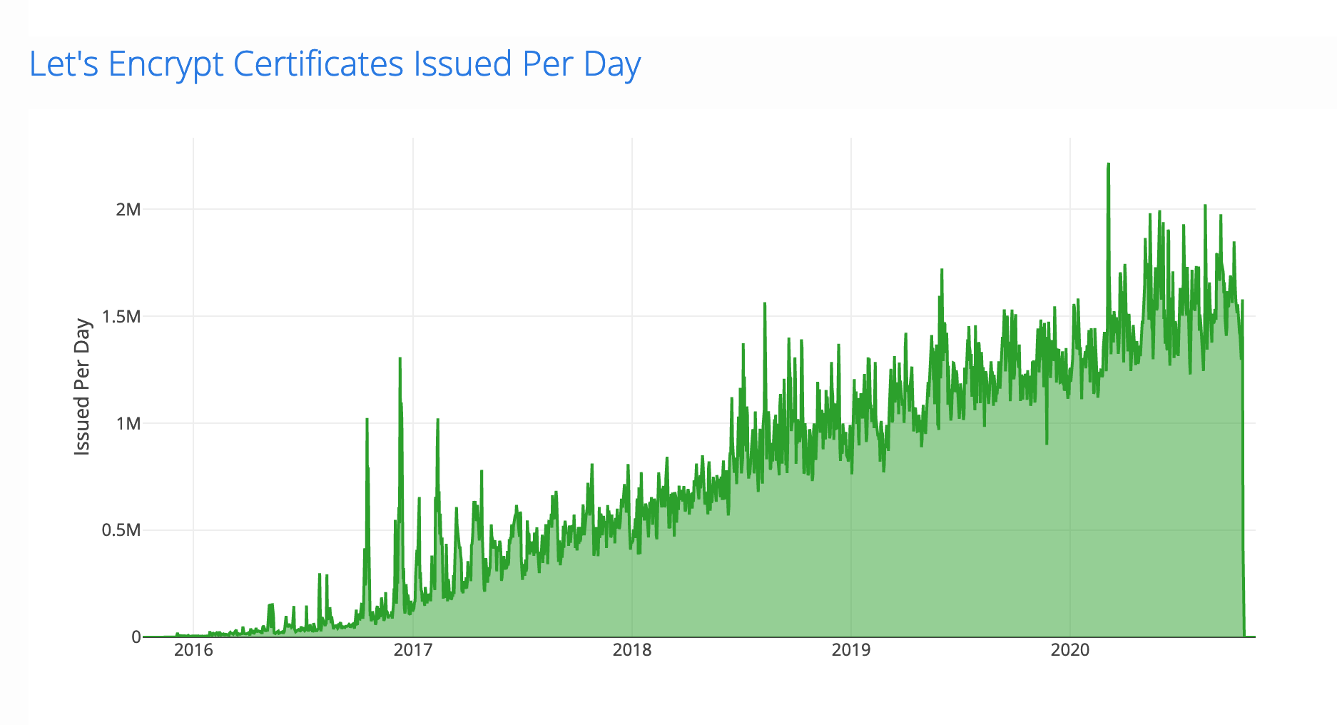
Let’s Encrypt Impact
Let’s Encrypt is a fully automated Certificate Authority that issues free short-lived site certificates.
Some researchers think that the proof of possession of such certificates may be more easily circumvented.

Slide 41
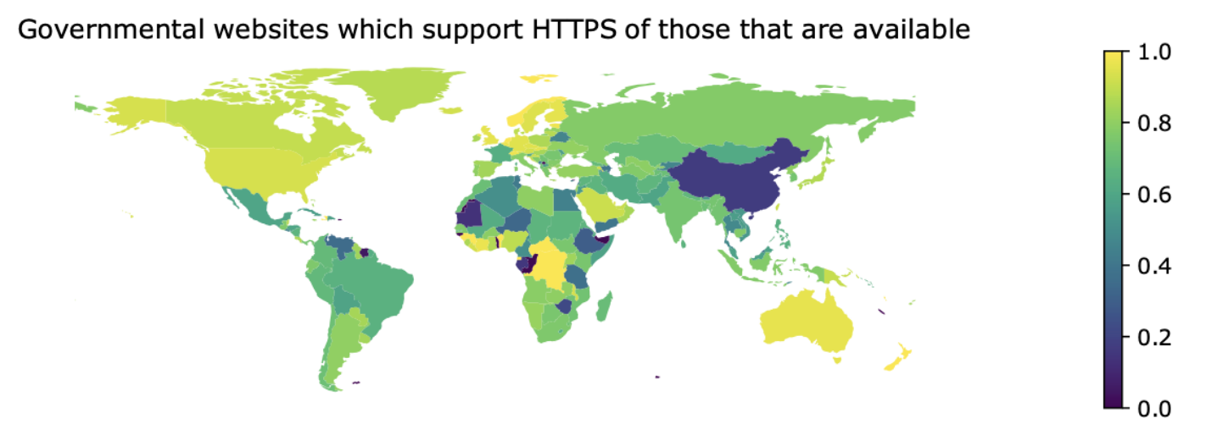
Example of the Long Tail – Governmental Sites
Percentage of visible governmental websites which support HTTPS of those that are available (made using a hand crafted set of governmental sites)
Source: https://blog.sudheesh.info/docs/2020-10-06-measuring-the-adoption-https-governments/

Slide 42
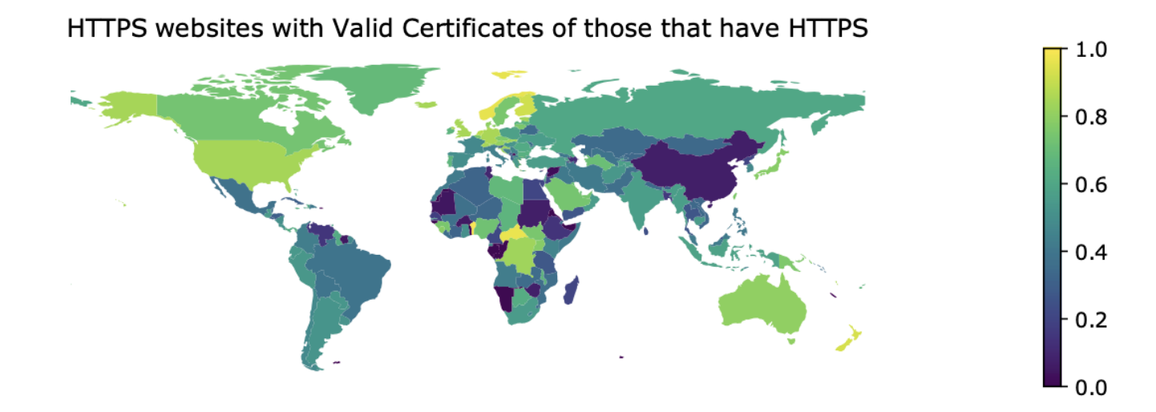
Support of Basic HTTPS is Not Enough
Percentage of govern-mental websites with valid certificates of those that have HTTPS
Source: https://blog.sudheesh.info/docs/2020-10-06-measuring-the-adoption-https-governments/

Slide 43
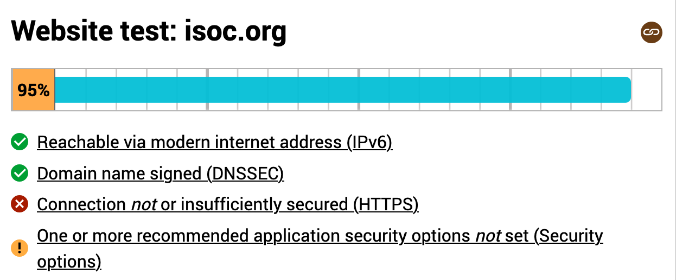
By Contrast
https://blog.sudheesh.info/docs/2020-10-06-measuring-the-adoption-https-governments/

