Slide 1
Internet — Past, Present (and Future) José Legatheaux Martins
An engineer point of view (by 2010)

Slide 2
Internet
How big is it today
How it was born and has grown, including in Portugal
Why is it different
What main challenges does it faces in next years

Slide 3
The Internet
Is the largest public communications network ever build
Will embrace and replace current telephone and television networks
Will become the privileged way to diffuse content (newspapers, music, films, books, ...)
Remote health assistance, surveillance and monitoring, ... will be increasingly supported by the Internet
Probably, even critical infrastructures monitoring and control (e.g. power grids) networks as well as critical closed business networks (e.g. Swift) will be integrated within the Internet
In a word, the Internet will become THE NETWORK

Slide 4
Number of unique IP addresses Worldwide (in millions)
Global | 465,0
USA | 124,9
China | 52,1
Japan | 32,2
Germany | 30,9
France | 21,4
UK | 20,0
South Korea | 16,1
Canada | 11,4
Spain | 10,8
Brazil | 10,7
The top 10 countries account for 71%
There are 186 countries with fewer than 1 M
There are 145 countries with fewer than 100 K
There are 32 countries with fewer than 1 K
Portugal may have around 10 M x 0.25 = 4 M
On average, quarterly growth is around 5% but the growth rate is decreasing
In Akamai 4th Q, 2009 The State of the Internet Report

Slide 5
Average Connection Speed (in Mbps)
Global | 1,7
South Korea | 11.7
Hong Kong | 8.6
Japan | 7.6
Romania | 7.2
Latvia | 6.2
Sweden | 6.1
Netherlands | 5.3
Czech Republic | 5.2
Denmark | 5.2
Switzerland | 5.1
Higher in (small) highly networked countries
The average connection speed is growing
The 100 top connected cities:
48% in Japan
62% in Asia
15% in Europe (6 countries)
21% in USA
23% in North America
College towns are some of the best connected cities in USA and Europe
In Akamai 4th Q, 2009 The State of the Internet Report

Slide 6
Internet Penetration (IP Per Capita)
Global | 0.07
Norway | 0.49
Finland | 0.44
Sweden | 0.43
Monaco | 0.41
Netherlands | 0.41
USA | 0.40
Denmark | 0.39
Iceland | 0.39
Germany | 0.38
Australia | 0.37
Akamai estimates that their servers “are visited” by one billion users per day
35 countries have penetration levels ≥ 0.25 IPPC while 73 countries have IPPC ≥ 0.1
Portugal should be in the 0.25 range
In Akamai 4th Q, 2009 The State of the Internet Report

Slide 7
What was the “Victorian Internet”
The Telegraph
Invented in the 1840s.
Signals sent over wires that were established over vast distances
Used extensively by the U.S. Government during the American Civil War, 1861 - 1865
Morse Code was dots and dashes, or short signals and long signals
The electronic signal standard of +/- 15 v. is still used in network interface cards today.
Copyright 2002, William F. Slater, III, Chicago, IL, USA

Slide 8
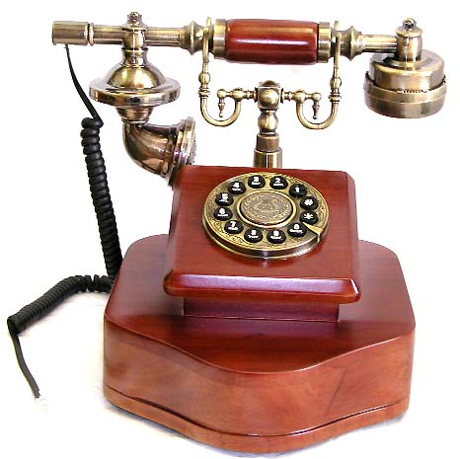
How to connect N (> 2) telephones ?

Slide 9
Wire (Circuit) Switching With Humans

Slide 10
During a Century the Telephone System
Become a highly sophisticated network allowing any two phones to automatically establish a virtual wire (circuit) connecting both devices
The “circuit” is based on the concatenation of several intermediate “circuits”, from telephone switch to telephone switch
Circuit establishment takes around 1 second and the conversation lasts several minutes

Slide 11
The Inteligent Network
Telephone circuits reliability is the product of intermediate circuit components reliability
P_{c} = P₁ . P₂ .... P_{n} = P^{n} (e.g. 0.9 x 0.9 x 0.9 = 0.729 …)
Telephone switches and their interconnections become critical, complex and very expensive
Telephones were “stupid” devices
At 10 Mbps transmission speed, the 1 second circuit establishment delay allows the transmission of 1 M Byte
The telephone network was mainly operated by national monopolies

Slide 12
Internet Origin
The Internet was created in simpler times. Its creators and early users shared a common goal — They wanted to build a network infrastructure to hook up all computers in the world together so that as yet unknown applications could be invented to run there.
in Tussle in Cyberspace: David Clark et al. “Defining Tomorrow’s Internet,” in Proceedings of SIGCOMM’02, 2002, USA

Slide 13
Some Internet Milestones up to 1995
Age of
eCommerce
Begins
1995
Mosaic
Created
1993
WWW
Created
1989
Internet
Named
and
Goes
TCP/IP
1984
ARPANET
1969
Packet
Switching
Invented
1964
A
Mathematical
Theory of
Communication
1948
1945
1995
Copyright 2002, William F. Slater, III, Chicago, IL, USA

Slide 14
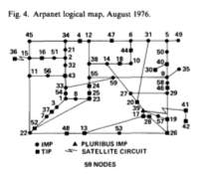
Arpanet Logical Map. August 1976
in I. K. Dalal and R. Metcalf, “Reverse Path Forwarding of Broadcast Packets,” CACM, December 1978, Volume 21, Number 12

Slide 15
Internet growth trends
1977: 111 hosts on Internet
1981: 213 hosts
1983: 562 hosts
1984: 1,000 hosts
1986: 5,000 hosts
1987: 10,000 hosts
1989: 100,000 hosts
1992: 1,000,000 hosts
2001: 150 – 175 million hosts
2002: over 200 million hosts
By 2010, about 80% of the planet will be on the Internet
Copyright 2002, William F. Slater, III, Chicago, IL, USA

Slide 16
Portugal — 1991
During 1991 several universities replaced their (illegal) IP networks by legally NIC registered networks
At the end of the 1st semester of 1991, IP packets were able to travel from the Portuguese RCCN backbone to the NSF backbone
International connectivity was made possible using a 64 Kbps X.25 circuit to EUnet in Amsterdam (IP over the “Telephone System”)
The PT DNS domain was established in September 1991 and officially recognized by the NIC in January 1992
From than on, Portuguese hosts were able to open TCP connections to the world the same way we do it today
First services were E-mail, Network News and FTP archives (at archie.inesc.pt, archie.ncc.up.pt, fct.unl.pt, uminho.pt, puug.pt, …)

Slide 17
Portugal Was Officially Recognized As Internet Connected in January 1992
“A terceira e última fase consistiu na aceitação pelo NIC do sistema nacional. Essa aceitação teve efeitos práticos no início do corrente ano (1992), momento a partir do qual os “root name servers” da Internet passaram a indicar que o servidor central do domínio “PT” (Portugal) é o servidor “ns.dns.pt”, uma máquina propriedade da FCCN, instalada na sua sede e dedicada em exclusivo à gestão do DNS do país. 0 domínio “PT” tem vários servidores secundários (“de backup”) nos EUA (Berkeley, Stanford e UUnet), na Europa (EUnet, INRIA, NORDUnet) e a nível nacional.”
In José Legatheaux Martins, “Relatório de execução do Projecto Serviço IP da RCCN durante o ano de 1991,” Março de 1992, Relatório Técnico da FCCN

Slide 18
Portugal Status at the end of 1991
FCCN, Univ. Porto, Minho, Aveiro, Lisboa, Nova, INESC, Coimbra, IST, LIP and PUUG were connected — 26 IP networks (25 old C networks and 1 old B network)
International connectivity: FCCN, Minho, Porto, Aveiro, INESC and PUUG
21 Domains with 933 registered hosts
Host ns.dns.pt received ≈ 5,000 queries / day
In José Legatheaux Martins, “Relatório de execução do Projecto Serviço IP da RCCN durante o ano de 1991,” Março de 1992, Relatório Técnico da FCCN

Slide 19
Portuguese IP Traffic in December 1991 (As Seen by RCCN Router GTRCCN2 in Bytes)
From / To | RCCN | RCCN int. | RCCN nat. | International | Total
RCCN | 1012404 | 838377 | 174027 | 299869 | 1312274
RCCN int. | 240598 | 79035 | 161563 | 275443 | 516342
RCCN nat. | 771805 | 759341 | 12464 | 24425 | 796231
International | 1430492 | 1430489 | 2 | 305 | 1430797
Total | 2442896 | 2288868 | 174030 | 380175 | 2743072
In José Legatheaux Martins, “Relatório de execução do Projecto Serviço IP da RCCN durante o ano de 1991,” Março de 1992, Relatório Técnico da FCCN

Slide 20
Portuguese IP Address Evolution
 | DNS Domains Portugal | IP Addresses Portugal | IP Addresses Europe | Portugal / Europe %
1991 January
1992 January | 25 | 820 | 141308 | 0,58 %
1993 January | 63 | 1901 | 303828 | 0,63 %
1994 January | 117 | 3382 | 587135 | 0,58 %
1995 January | 130 | 5521 | 1106077 | 0,50 %
1996 January | 411 | 12698 | 2284750 | 0,56 %
1996 July | 512 | 15776 | 3017784 | 0,52 %
In José Legatheaux Martins, “Evolução Tecnológica da Internet em Portugal,” Ingenium – Revista da Ordem dos Engenheiros, 2ª Série, N.º 17, Maio 1997, pp.s 70 - 78

Slide 21
Internet — The Stupid Network
Packet switching
Messages are divided in small pieces — data packets
Packet headers have source and destination addresses
Packets are transported by best effort
Packets can be lost by the network
Packets can be corrupted
Packets can be delivered out of order
source
destination
IP network

Slide 22
Why a Stupid Network ?

Slide 23
Systems Design Principles
KISS — Keep It Simple, Stupid !
Interfaces
Information Hiding
Layering
Hierarchy

Slide 24
The Internet Protocol Suite
FTP
HTTP
NV
TFTP
Applications
TCP
UDP
UDP
TCP
Waist
IP
Data Link
NET₁
NET₂
…
NET_{n}
Physical
The Hourglass Model
The waist facilitates interoperability

Slide 25
Layer Encapsulation
User A
User B
Get index.html
Connection ID
Source/Destination
Link Address

Slide 26
End to end arguments
One of the most respected and cited of the Internet design principles is the end to end arguments, which state that mechanisms should not be placed in the network if it can be placed in the end node, and that the core of the network should provide a general service, not one that is tailored for a specific application. There are two general dimensions to the arguments: innovation and reliability.
In Tussle in Cyberspace: David Clark et al. “Defining Tomorrow’s Internet,” in Proceedings of SIGCOMM’02, 2002, USA

Slide 27
Keep Complexity Under Control
Perfection is reached not when there is no longer anything to add, but when there is no longer anything to take away.
Antoine de Saint Exupéry

Slide 28
The Intelligent Network Revenge
By 1994 the Internet become main stream in most western countries
By 1995 the NSF Backbone was dismantled and replaced by several private backbones
By 2000 most Internet big players were owned (or tightly connected) to the main Telecoms of the world — the deep pocket guys

Slide 29
The Stupid Network Today
Channels | 1980 | 1990 | 2010 | 2015
End User Average Interface Speed | 2,4 K bps | 2,4 K bps | 10 M bps | 100 M bps
End User Advanced Interface Speed | 2,4 K bps | 9,6 K bps | 100 Mbps | 1 G bps
Backbone Average Interface Speed | 64 K bps | 64 K bps | 10 G bps | 100 G bps
Backbone Advanced Interface Speed | 128 K bps | 512 K bps | 100 G bps | 1 T bps
Computers | 1970 | 2010
End User Average Computer RAM | — | 2 G Bytes
End User Average Computer Speed | — | 1500 MIPS
Advanced Average Computer RAM | 64 K Bytes | N times 36 G Bytes
Advanced Average Computer Speed | 0.010 MIPS (10 KIPS) | N times 3000 MIPS

Slide 30
World Wide IP Transported Data
By Type (PB per month) | 2009 | % | 2013 | %
Internet IP | 11 627 | 78,8 % | 40 401 | 72,7 %
Non-Internet IP | 3 031 | 20,5 % | 12 975 | 23,3 %
Mobile IP | 85 | 0,5 % | 2 184 | 3,9 %
Total | 14743 |  | 55 560
1 PB = 1 Peta Byte = 1 000 000 000 000 000 = 10¹⁵ Bytes = 1 Quadrillion or 1000 Tera Bytes (1 DVD = 8 x 10⁹ bytes)
Internet denotes all IP traffic that crosses an Internet Backbone
Non-Internet IP denotes IP WAN Traffic, IP transport of TV or VoD (inside a closed Backbone)
Mobile includes mobile data generated by handsets, notebook cards, …
In Cisco Visual Network Index: Forecast and Methodology, 2008 - 2013

Slide 31
IP Transported data – cont.
By Segment | 2009 | % | 2013 | %
Consumer IP | 10 399 | 70,5 % | 40 543 | 72,9 %
Business IP | 4 258 | 28,8 % | 12 833 | 23,0 %
Mobile IP | 85 | 0,5 % | 2 184 | 3,9 %
Total | 14743 |  | 55560
1 PB = 1 Peta Byte = 1 000 000 000 000 000 = 10¹⁵ Bytes = 1 Quadrillion or 1000 Tera Bytes (1 DVD = 8 x 10⁹ bytes)
Consumer denotes all Internet traffic generated by households, universities, cafés, …
Business denotes all IP traffic generated by business and government (private WANs and Internet transported)
Mobile includes mobile data and Internet data generated by handsets, notebook cards, …
In Cisco Visual Network Index: Forecast and Methodology, 2008 - 2013

Slide 32
Inter AS Consumer transported data
By Sub-Segment | 2009 | % | 2013 | %
Web/Mail | 1 595 | 18,2 % | 3 965 | 12,3%
File Sharing P2P | 4 083 | 46,6 % | 9 629 | 29,9%
Online Gaming | 87 | 0,99 % | 239 | 0,74%
Consumer VoIP | 129 | 1,4 % | 190 | 0,5 %
Live Video Communications | 57 | 0,6 % | 354 | 1,1 %
Video to PC (pay TV, VoD, YouTube \ Vo P2P) | 2 431 | 27,7 % | 12 442 | 38,7 %
Video to TV (same to a TV set) | 149 | 1,7 % | 2 594 | 8 %
Ambient Video (security cams, …) | 224 | 2,5 % | 2 715 | 8,4 %
Total | 8755 |  | 32129
In Cisco Visual Network Index: Forecast and Methodology, 2008 - 2013

Slide 33
Some Observations (if we trust the forecast)
A very large fraction of Internet and IP traffic is inter-AS (around 60%)
1000 M users (1000 M computers ?) exchange 30 P Bytes per day globally
Internet backbone traffic is expected to grow 7 times in 4 years
Interactive real time one-to-one or many-to-many communications only represent 2.5%

Slide 34
Some observations (cont.)
Probably, more than 75% is video distribution (P2P + video)
Hopefully, some promising / interesting consumer applications require upload capacity (e.g. ambient video ≈ 8,4 %)
Small to medium duration TCP connections (Web, Mail, P2P) will decrease from ≈ 60% to ≈ 42% )
Long single sourced transfers (TCP and IP Multicasting) will increase from ≈ 31% to ≈ 55 %

Slide 35
Internet Problems as of Today
One billion users exchange globally ≈ 30 PB per day
Will it
scale to accommodate the expected needs ?
become reliable and secure ?
become a giant big brother ?
remain application neutral and open to innovation ?
remain universal and open in all countries ?

Slide 36
The Problems of Scale
Channels | 1980 | 1990 | 2010 | 2015
End User Average Interface Speed | 2,4 K bps | 2,4 K bps | 10 M bps | 100 M bps
End User Advanced Interface Speed | 2,4 K bps | 9,6 K bps | 100 Mbps | 1 G bps
Backbone Average Interface Speed | 64 K bps | 64 K bps | 10 G bps | 100 G bps
Backbone Advanced Interface Speed | 128 K bps | 512 K bps | 100 G bps | 1 T bps
By Segment PB | 2009 | % | 2013 | %
Consumer IP | 10 399 | 70,5 % | 40 543 | 72,9 %
Business IP | 4 258 | 28,8 % | 12 833 | 23,0 %
Mobile IP | 85 | 0,5 % | 2 184 | 3,9 %
Total | 14743 |  | 55560
How many globally unique IP addresses will we need ?
How to accommodate billions of new mobile users ?

Slide 37
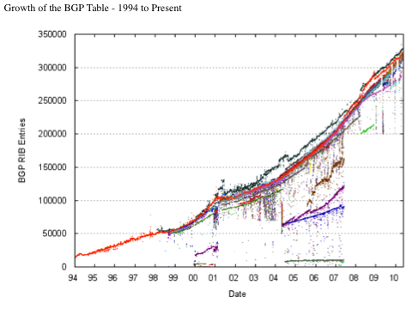
Scaling The Backbone — BGP Prefixes
In http://bgp.potaroo.net

Slide 38
Scale in the Backbone — BGP Updates
7 Day BGP Profile: 24-April-2010 00:00 - 30-April-2010 23:59 (UTC+1000)
Number of BGP Update Messages: 608618
Number of Prefix Updates: 1263963
Number of Prefix Withdrawals: 95959
Average Prefixes per BGP Update: 2.23
Average BGP Update Messages per second: 0.88
Average Prefix Updates per second: 1.97
Peak BGP Update Message Rate per second: 1032
(04:59:53 Tue, 27-Apr-2010)
Peak Prefix Update Rate per second: 787
(11:56:15 Tue, 27-Apr-2010)
Peak Prefix Withdraw Rate per second: 4268
(04:59:53 Tue, 27-Apr-2010)
Prefix Count: 329975
In http://bgp.potaroo.net

Slide 39
Complex Networks
A new discipline is emerging: Network Science

Slide 40
AS Graph

Slide 41
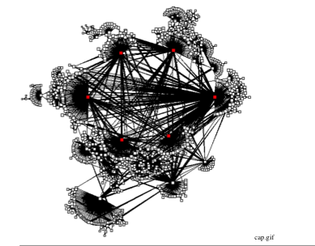

Slide 42
The Power of Economics
Providers income comes from:
Network service and video (low margin)
Content, e.g. TV, films, soap producers, sold in bulk to network service providers
Advertisement, e.g. Google and all the other Web 2.0 application providers (high margin ?)
Content retailers, e.g. iTunes, …
Individual content owners (the Apple Application Store model ?)
As 55 % of the traffic will become single sourced video (which providers know how to bill) and due to the low margins of network operators, there is a big danger of vertical integration between network operators and the other providers

Slide 43
Reliability and Trust ability
Scale is introducing concentration and more and more giants
Are we returning to the old telephone network model, being dependent of a small number of operators and giant switches?
The so called Cloud (supporting the Web 2.0 applications) is a playground of a dozen of global operators
Will giants and States fight or collude to control the Internet ?
The “community” still has some power ?

Slide 44
Empower The Core And The Ends (Ends = Users ?)
Legislation and regulation must promote diversity (number of providers, exploitation of alternative access technologies, …) at the core and in the edge
Researchers must find ways to scale global routing and addressing issues
Researchers must find ways to increase the support of diversity
Several interfaces in devices
Several simultaneous providers
Allow ends (users ?) to choose routes and intermediate providers

Slide 45
Security, Reputation, Traceability
An Internet completely main stream, requires enhanced security and traceability mechanisms
Denial of service prevention requires changes in the current transport protocols
Will the Internet become a Big Brother ?

Slide 46
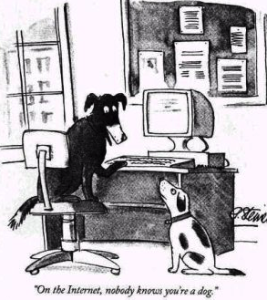
Privacy — The Good Old Days

Slide 47
Empower the ends (users ?)
Research ways to support and increase network diversity
Research privacy, authentication and reputation mechanisms
Research payment systems allowing individuals, small to medium business to flourish and network providers to bill QoS, multicast and upload capacity on demand
…..
Develop the next big paradigm shift, but expect it to run as a new layer ….

Slide 48
If You Want to Become an Internet Tec. Leader (Whatever it Means)
Think long term
Emphasize principles, not facts
Understand reality
Expect paradigms shift
Study how things work inside
Learn how to master complexity
Try to solve real problems
Ignore hype
Don’t forget the past
A. S. Tanenbaum and D. Paterson

